Slide 1

Mercedes-Benz Business Analytics
Cars run on fuel — but businesses run on data. This project delivers a comprehensive, end-to-end analytics pipeline to decode sales performance, customer behavior, and market dynamics across Mercedes-Benz's global operations, transforming raw data into strategic business intelligence.
BUSINESS INTELLIGENCE
AUTOMOTIVE ANALYTICS
GROWTH INSIGHTS

Slide 2
Project Overview
From Raw Data to Strategic Decisions
Overview of my work
Core Objectives
Analyzed Mercedes-Benz's global sales, product performance, and customer trends through a structured analytics pipeline. It evaluates key performance indicators — revenue, profitability, regional demand, and customer segmentation — to support strategic planning and operational efficiency.
Understand customer preferences and purchasing decisions globally
Identify product trends and model-level performance
Uncover profitability gaps across regions and segments
Deliver interactive dashboards for executive decision-making
Provide a financial overview and growth roadmap for 2026

Slide 3

Business Background
Mercedes-Benz: A Global Luxury Leader
Mercedes-Benz is one of the world's most recognized luxury automobile manufacturers, with a presence spanning dozens of countries and customer segments. This analysis leverages sales, product, customer, and regional data to evaluate performance across the entire business — from individual model profitability to country-level market demand. Insights generated are designed to support stake-holder decisions on inventory, manufacturing, marketing, and expansion strategy.

Slide 4


Problem Statement
Critical Business Challenges to Address
Global Market Visibility
Customer & Segment Clarity
No consolidated view of the global customer base and market trends, limiting the ability to capitalize on sales and profit opportunities at scale.
Insufficient segmentation data to identify which customer profiles and market segments to prioritize in upcoming years.
Underperforming Markets
Customer Preference Intelligence
Lack of actionable intelligence on how to scale operations and improve profitability in currently underperforming countries.
No centralized system to track, analyze, and act on customer preferences and purchasing decision patterns.
Manufacturing Alignment
Financial Forecasting Gap
Model demands are unclear, making it difficult to align production planning with actual market needs.
Absence of a structured financial overview and performance statistics for the 2026 planning cycle.

Slide 5

Dataset Composition
Five Core Tables Powering the Analysis
Sales
Customers
Dealers
Date
Product

Slide 6
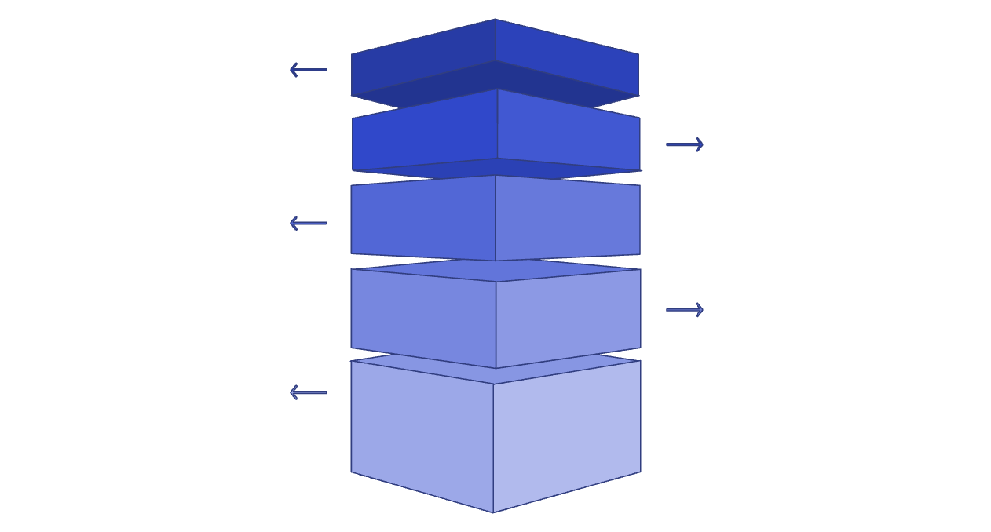
Methodology
End-to-End Analytics Framework
Business
Recommendations
Power BI
SQL Analysis
Python
(Data Manipulation & EDA)
Data Prep

Slide 7



Tools & Technologies
The Analytics Stack
Python — Pandas, NumPy
MySQL — Business Queries
Used for data ingestion, cleaning, transformation, and feature engineering. Pandas handled dataframe manipulation while NumPy supported numerical computations and statistical analysis during the EDA phase.
Served as the analytical engine for executing complex business queries, aggregations, joins across the five tables, and performance analysis — translating raw data into structured business answers.
Power BI — Dashboards & KPIs
Delivered the final layer of interactivity through dynamic dashboards, KPI reporting, and visual storytelling — making insights accessible and actionable for business stakeholders and executives.

Slide 8
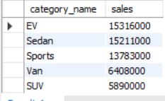

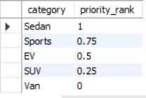
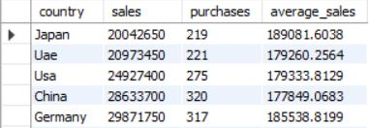
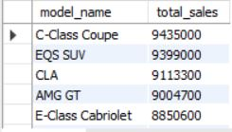
SQL Analysis
From SELECT * to Business Insights
Which products should receive increased marketing investment?
Which product categories generate strong sales with minimal discounts?
Which vehicle category should Mercedes focus on based on profitability?
Which countries represent the greatest
market expansion opportunity- (that have: Low total sales, Low number of
purchases but
High average sales per order)?
Mercedes model wise total revenue generated from highest to low

Slide 9
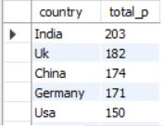

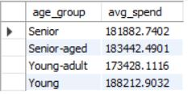

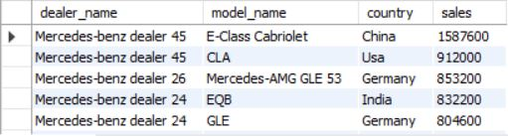
Which customer country has the highest number of purchases?
Which country has the highest average order value?
What is the average spending by each age group?
In Which quarter highest sales generated ?
Which combination of dealer, model, and country generates the highest overall revenue?

Slide 10


Dashboard & Visualization
Interactive Power BI Reporting
Power BI helped transform analytical outputs into executive-ready dashboards. Stakeholders can filter by each quarter, product model, customer segment to explore performance in best possible way.
KPI Scorecards
Track total sales, profit, cars sold, average profit, dealers, and
countries covered.
Monthly Sales Trends
Visualize monthly sales performance to identify seasonal patterns and
growth trends..
Category & Fuel Analysis
Compare sales across vehicle categories
and fuel types to understand product performance
Geographic Performance
Analyze sales and profit distribution across countries and key markets.

Slide 11
Actionable Insights
EV demand continues to grow, generating total sales of 15.32M.
India recorded the highest sales among all countries.
The G- Class model recorded the lowest sales among all models.
July generated the highest profit of 4.44M.
Diesel vehicles contributed the highest sales, totaling 73.39M.
The average order value was 182.73K.

Slide 12
Business Recommendations
Invest in charging infrastructure partnerships and EV awareness campaigns to accelerate EV adoption.
Increase investment in EV models to capitalize on growing demand.
Expand marketing and dealership presence in high-performing countries, especially India.
Identify reasons and gaps related to - pricing, features, and promotional strategy for the lowest-performing model.
Analyze the factors behind July's peak profitability and repeat successful campaigns in other months as well.
Maintain adequate inventory for Diesel vehicles + continuously look after towards the transition toward EV adoption.
Focus more on marketing efforts for high-demand vehicle categories to maximize revenue.
Optimize production planning based on regional demand and seasonal sales trends.
Introduce targeted promotional offers in low-performing regions to improve sales.
Continuously monitor ongoing trends and customer preferences to tailor overall operations.
Improve forecasting using historical sales and profit patterns to optimize inventory and supply chain operations.

Slide 13

Conclusion
Business Intelligence Driving Mercedes-Benz Forward
This project demonstrates how a structured, end-to-end analytics pipeline — combining Python, MySQL, and Power BI — can transform raw automotive sales data into actionable strategic intelligence. By addressing critical gaps in customer insight, market segmentation, regional performance, and financial forecasting, the analysis equips Mercedes-Benz decision-makers with the clarity needed to optimize manufacturing, target the right segments, and scale profitability across global markets heading into 2026 and beyond.
5
3
Data Tables
Tool Layers
Disclaimer ⚠️
Integrated across the full analytics pipeline
Python → MySQL → Power BI
The dataset and Mercedes-Benz logo used in this project is intended solely for educational and portfolio purposes. It does not represent official or proprietary company data, and any analysis or conclusions are based on the available sample data.
6
Business Problems
Critical challenges addressed through analysis
.

